Slide 1

SQL - Basics

Slide 2
Contents
What is Data?
Relational Databases
SQL - A Brief Intro
Advantages and Disadvantages of SQL
Entity Relationship Diagram
SQL Statements
Read Tables: The SELECT Query
Set rules to our SELECT Queries

Slide 3
What is Data
First of all, what is data? This course covers Data Science after all, we need to know a brief definition of data
Data can be thought of as recorded measurements of something in the real world. This something is a unit of observation.
For example, a list of people’s height is data.
A person would be the unit of observation (sample)
Data can describe a vast amount of different things.
For example, there is a lot of data we can use to describe a person.
Each measurement is called a variable (feature)
Each observation (the hight of a person) is a data point
Several data points together create a Dataset

Slide 4
Relational Database
Data is useful to obtain valuable information. We could analyze now that data by hand, but of course, computers can analyze much more information than humans. There are two tools for storing, organizing, and processing data in a computer. The first one is:
Relational Database:
Utilizes the relation model of data: Redundant data is used to link records in different tables
Data is organized as relations, containing a relation key (ID)
Relations are usually implemented as Tables
Tables are assimilated in common collections in databases called Schemas
For example: One Table contains (ID, Name, Last Name, Age)
Another Table contains (ID, Height, Smoker?)
And another Table contains (Smoker?, Cancer Development)
The software used to manage relational databases is referred to as a Relational DataBase Management System (RDBMS)

Slide 5
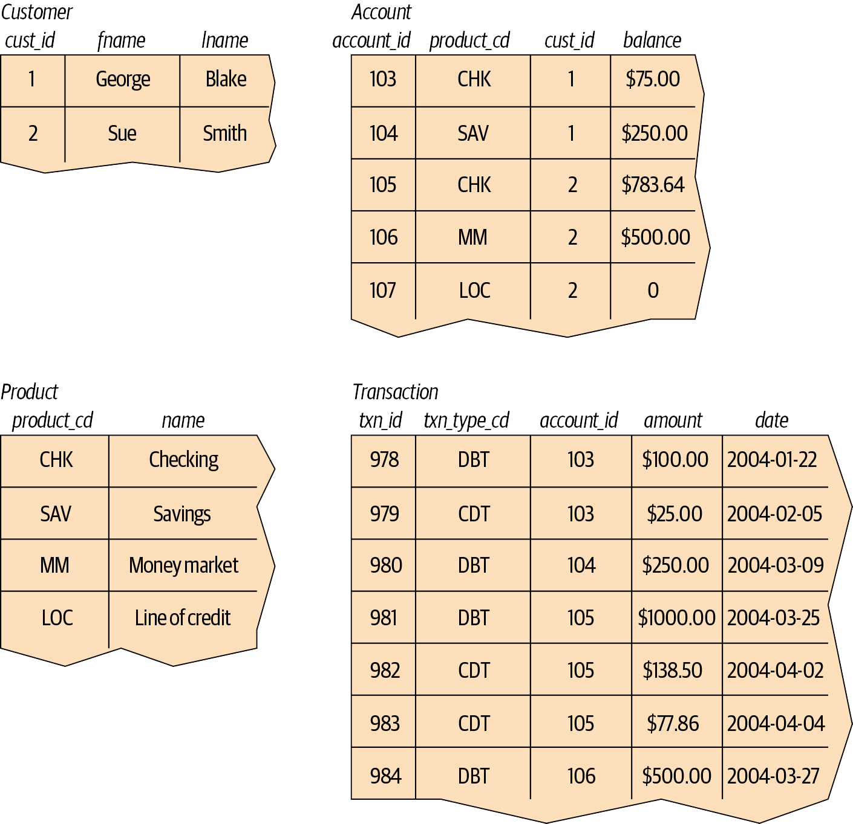
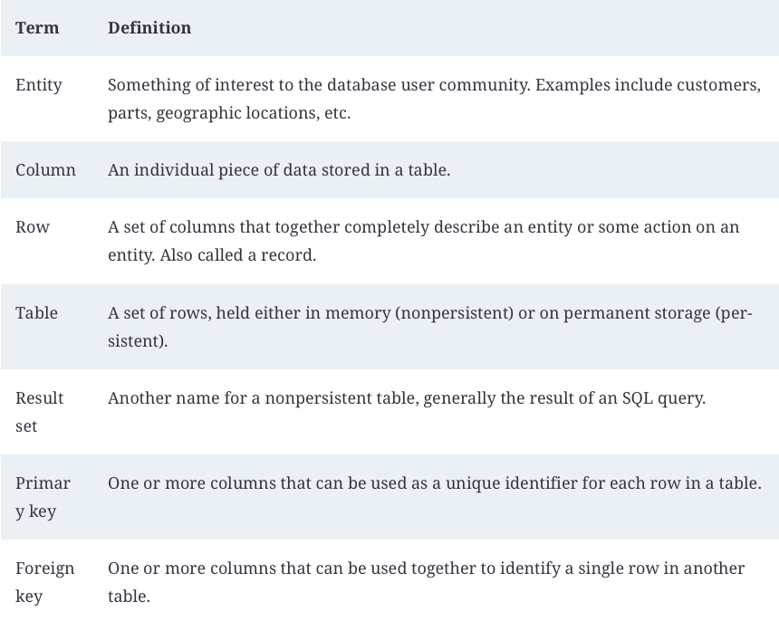
Relational Database
Redundant data is used to link records in different tables

Slide 6
SQL - A brief intro
“Along with Codd’s definition of the relational model, he proposed a language called DSL/Alpha for manipulating the data in relational tables. Shortly after Codd’s paper was released, IBM commissioned a group to build a prototype based on Codd’s ideas. This group created a simplified version of DSL/Alpha that they called SQUARE. Refinements to SQUARE led to a language called SEQUEL, which was, finally, shortened to SQL. While SQL began as a language used to manipulate data in relational databases, it has evolved […] to be a language for manipulating data across various database technologies […]
One final note: SQL is not an acronym for anything (although many people will insist it stands for “Structured Query Language”). When referring to the language, it is equally acceptable to say the letters individually (i.e., S. Q. L.) or to use the word sequel.”
Extracted from ‘Learning SQL’ by Alan Beaulieu

Slide 7
SQL - Pros and Cons
SQL Databases provide a ton of Advantages that may it the de facto choice for many applications
Intuitive: Relations that almost anyone can understand
Efficient: They use normalization so it doesn’t repeat its representation (less space)
Declarative: You tell the data that you want, and the system takes care of how to execute the query
Robust: Most databases have the ACID compliance (Atomicity, Consistency, Isolation, and Durability), guaranteeing the validity of data even if the hardware fails

Slide 8
SQL - Pros and Cons
However, we might find some Downsides when working with SQL databases:
Lower specificity: Sometimes, SQL’s functionality is limited to what it has been programmed to do. Not common though, since it management systems get updated
Limited Scalability: Due to the robustness might be an impediment for scaling data.
Object-relation mismatch impedance: Sometimes objects have attributes with many-to-many relationships. For example, a costumer may own multiple products, but each product may have multiple objects

Slide 9
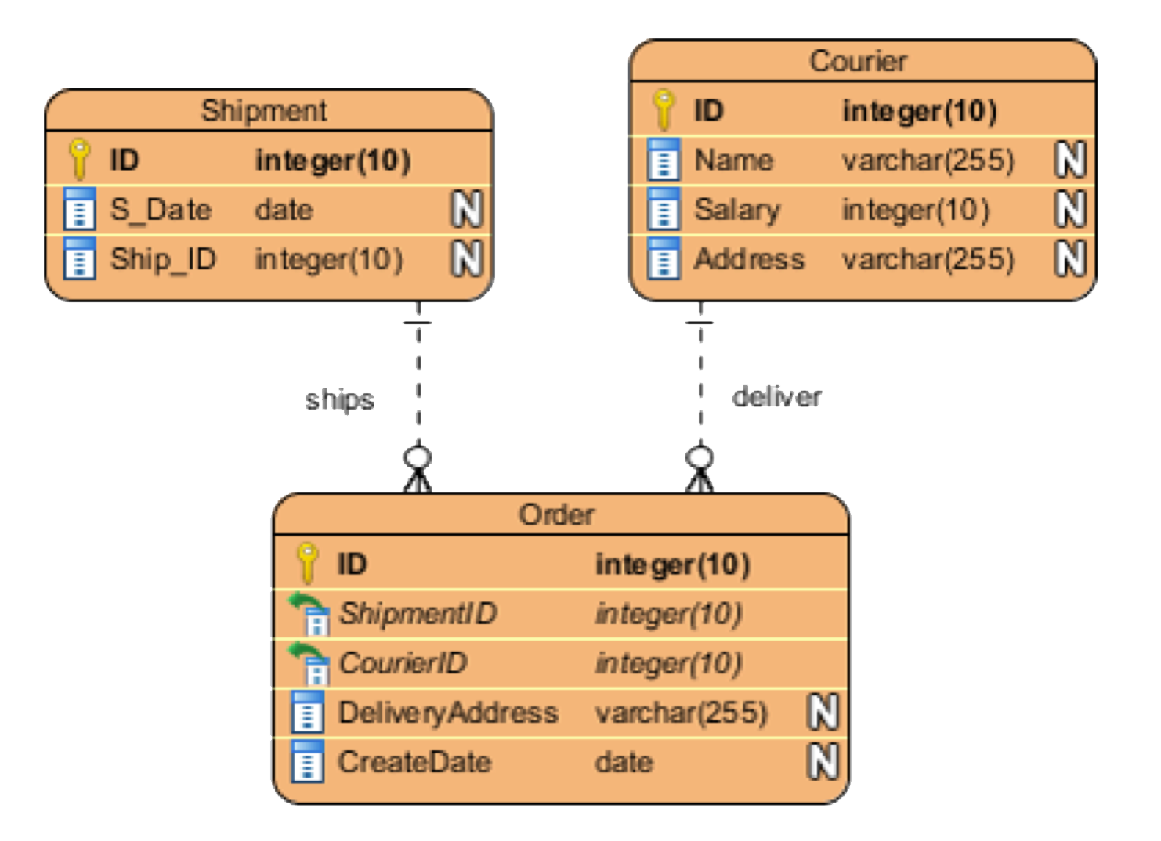
SQL - Entity Relationship Diagram
Entity Relationship Diagram (ERD) is a type of structural diagram for use in database design. An ERD contains different symbols and connectors that visualize two important information: The major entities within the system scope, and the inter-relationships among these entities.
Primary Keys: uniquely defines a record in a database table.
There must not be two (or more) records that share the same value for the primary key attribute.
For example (ID)
Foreign Keys: reference to a primary key in another table. It is used to identify the relationships between entities.
They don’t need to be unique
For example (ShipmentID, CourierID)

Slide 10
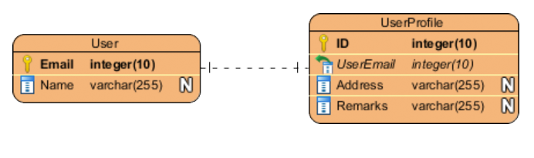
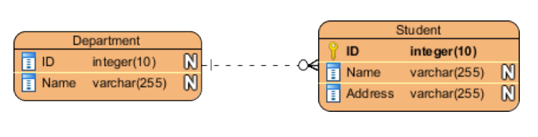
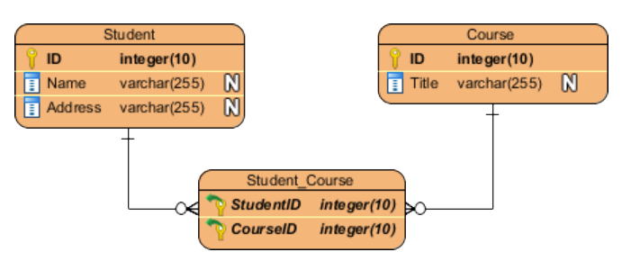
SQL - Entity Relationship Diagram
Cardinality: possible number of occurrences in one entity which is associated with the number of occurrences in another.
For example, ONE team has MANY players. Then Team and Player are inter-connected with a one-to-many relationship.
One to One Relationship | One to Many Relationship | Many to Many Relationship

Slide 11
SQL - Statements
Databases have four main statements, following the CRUD (Create, Read, Update, Delete) paradigm. Statements can essentially be thought of as functions we want to perform over the database. Within a given database, relevant statements could include:
CREATE TABLE: A statement which creates a new table in the database
SELECT: Allows you to read and query the database to extract records you want
UPDATE: Allows you to update records within a table
DROP TABLE: Gives you the power to remove a table from a database
SQL Statements and Keywords are, by convention, UPPERCASE

Slide 12
SQL - Use Case
It’s time to get our hands dirty. By now you should already have PostgreSQL installed. If not, open the SQL_Setup.md in the repo and follow the steps included in the file.
We're going to be working with a database known as Pagila
PostgreSQL port of an open-source sample database known as Sakila (A sample database for learning purposes)
Pagila is a database which models a DVD rental store. It features films, actors, film-actor relationships, and a central inventory table that connects films, stores, and rentals.

Slide 13
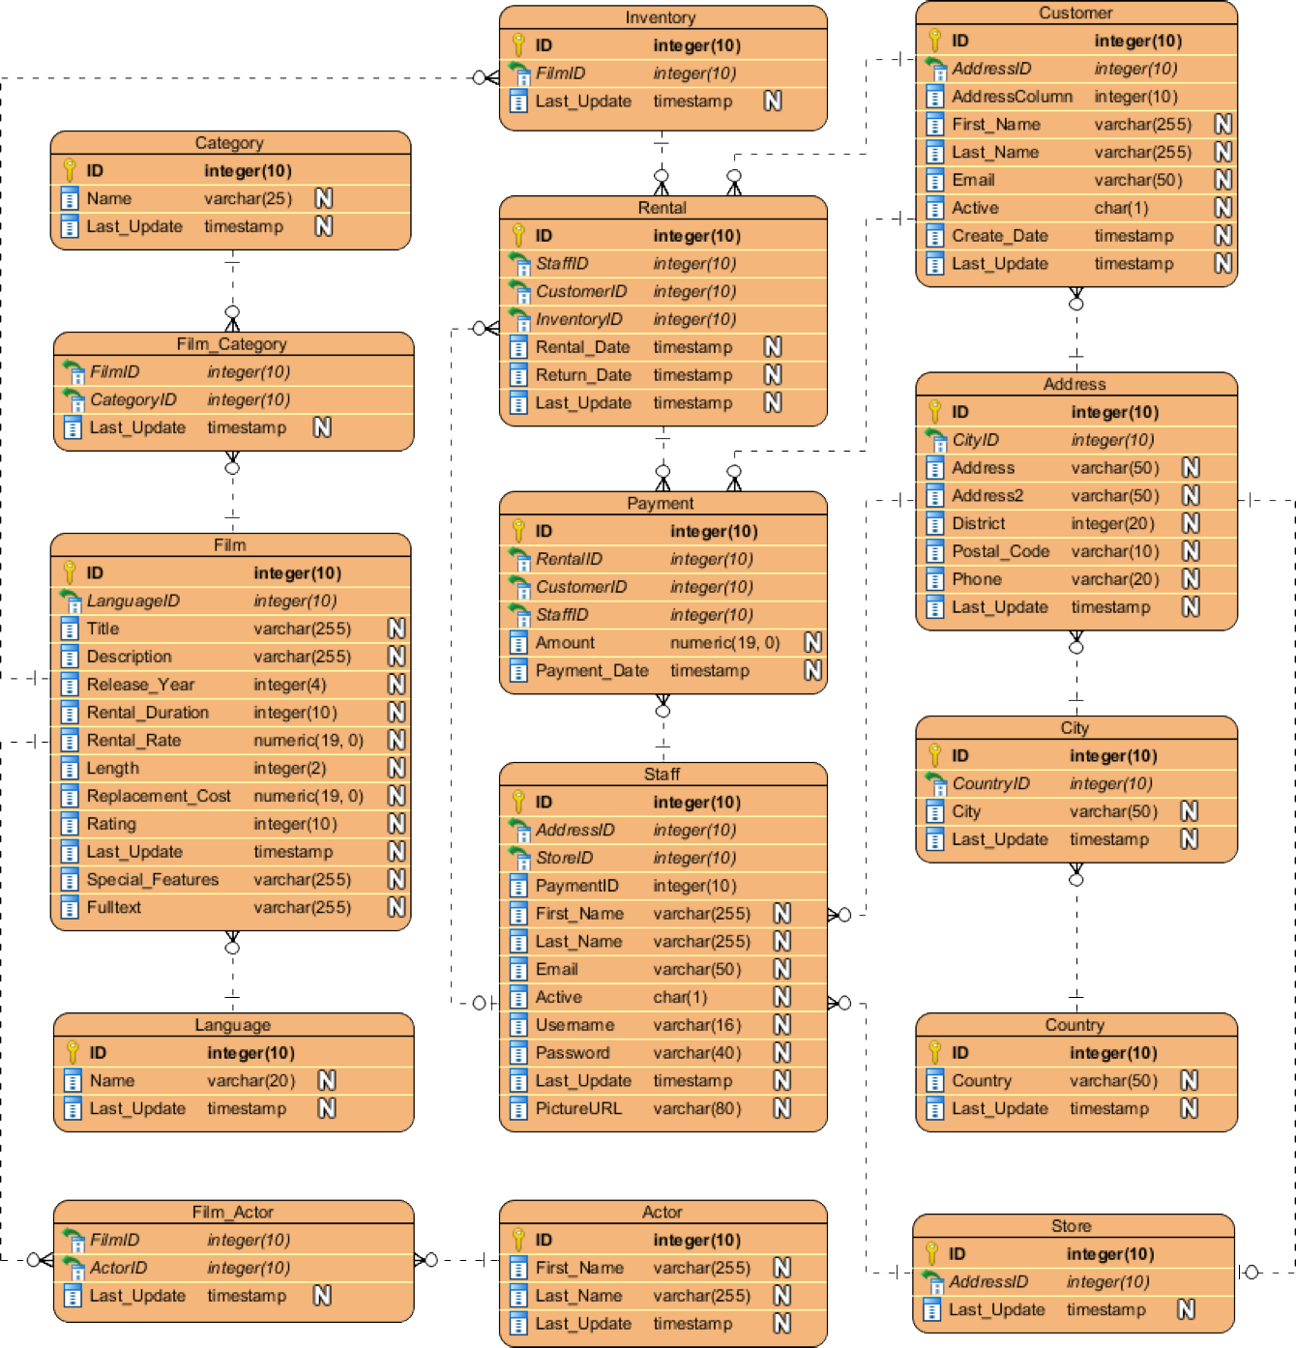
SQL - Use Case

Slide 14
SQL - SELECT Statement
The most common operation in a database is reading data from it. We can do it using the SELECT keyword. Let’s see the basic anatomy of a SELECT keyword:
Operation: What is going to be done. SELECT followed by the names of columns (* indicates all columns)
Data: FROM where we are getting the data (SELECT * FROM payments: select all columns from the payments entity). Data can also be obtained from the combination of existing columns using arithmetic operations
Post-Processing: It takes the results of a query and sort them or limit them by using ORDER BY and LIMIT
Conditional: Acts as a filter. Usually indicated by WHERE
Grouping: Assemble the rows of a data source using a key created by a GROUP BY clause.
Two small notes:
Statements terminate with a semi-colon
SQL ignores whitespace

Slide 15
SQL - Post Processing
LIMIT
It allows us to limit the number of records
It’s the last part part of the query
SELECT *
FROM payment
LIMIT 10;
ORDER BY
It allows us to specify which columns we want our returned data ordered by
Ascending by default. We can specify DESC
We can also sort multiple columns, and the sorting occurs from left to right
Placed before LIMIT
SELECT *
FROM film
ORDER BY rental_rate DESC, length DESC;
LIMIT 10

Slide 16
SQL - Practicals (Part I)
Take a look at the ERD in the Pagila database and attempt the first practical (“Use the SELECT query to read the following data from the Pagila database”)

Slide 17
SQL - SELECT Statement
The most common operation in a database is reading data from it. We can do it using the SELECT keyword. Let’s see the basic anatomy of a SELECT keyword:
Operation: What is going to be done. SELECT followed by the names of columns (* indicates all columns)
Data: FROM where we are getting the data (SELECT * FROM payments: select all columns from the payments entity). Data can also be obtained from the combination of existing columns using arithmetic operations
Post-Processing: It takes the results of a query and sort them or limit them by using ORDER BY and LIMIT
Conditional: Acts as a filter. Usually indicated by WHERE
Grouping: Assemble the rows of a data source using a key created by a GROUP BY clause.
Two small notes:
Statements terminate with a semi-colon
SQL ignores whitespace

Slide 18
SQL - Conditional
WHERE:
It allows us to specify which columns we want our returned data ordered by
Common condition symbols are:
>, >= Greater than, greater than or equal to
<, <= Less than, less than or equal to
= Equal to
!= Not equal to
SELECT *
FROM payments
WHERE customer_id = 72;

Slide 19
SQL - Arithmetic Operations
It’s possible to return a new column from a combination of existing columns
We derive/compute this new column using mathematical operators: +, - , * , /
Usually we alias the new column using the AS keyword
SELECT title, (rental_rate/rental_duration) AS rental_rate_per_day FROM film;

Slide 20
SQL - Practicals (Part II)
Take a look at the ERD in the Pagila database and attempt the second practical (“Using Simple Conditional Statements to filter the data”)

Slide 21
SQL - More on Conditional
SQL allows us access to operations that improves the conditional statement WHERE
LIKE: Similar to WHERE =, but in cases you’re not entirely sure what you’re searching for
IN: Similar to WHERE =, but for more than one condition
NOT: Used to return opposite results from LIKE or IN (e.g. NOT LIKE or NOT IN)
AND & BETWEEN: Allows us to combine operations
OR: Allows us to find data where one of the conditions we provide to the query is true

Slide 22
SQL - LIKE
LIKE is typically performed on string based columns
Allows us to match strings using wildcards:
One wildcard character in SQL is %
Represents zero or more characters
Case sensitive
Remember to use single quotes in the query
SELECT * FROM film WHERE description LIKE '%Drama%'

Slide 23
SQL - IN
IN can be used with both string and numeric data types
Essentially allows us to use an =, but over more than one condition
SELECT * FROM language WHERE name IN ('English', 'Italian')
SELECT * FROM film WHERE language_id IN (1, 2)

Slide 24
SQL - NOT
NOT allows us to inverse the results of the previous queries
SELECT * FROM category WHERE name NOT IN ('Action', 'Animation')
SELECT * FROM actor WHERE last_name NOT LIKE '%SON'

Slide 25
SQL - AND
We use AND when we want to run/check against multiple conditions
We can link as many expressions as we want
Of different types too… LIKE, IN, and NOT can all be linked by AND
SELECT * FROM payment WHERE payment_date >= '2017-01-25'
AND payment_date <= '2017-01-29'
SELECT * FROM payment WHERE payment_date < '2017-01-25' AND staff_id = 2

Slide 26
SQL - OR
Similar to AND, OR combines multiple statements. However, with OR, only one of the conditions we specify needs to be true (instead of all cases as is the case with AND)
SELECT * FROM film WHERE rental_duration < 5 OR length > 120

Slide 27
SQL - BETWEEN
When we want to specify a range between data on the same column (like we did in the previous slide), it is easier and cleaner to use BETWEEN
Works with dates, strings and numbers
SELECT * FROM payment WHERE payment_date BETWEEN '2017-01-25' AND '2017-01-29';
SELECT customer_id, payment_date, amount
FROM payment
WHERE amount BETWEEN 10.0 AND 11.99;

Slide 28
SQL - Practicals (Part III)
Take a look at the ERD in the Pagila database and attempt the third practical (“Applying filters to SQL queries”)

